Slide 1


Ohio Children’s Caucus
Friday, June 10, 2020
Teresa L. Kobelt, MSW, LSW
Director – Strategy, Innovation, Forecasting

Slide 2
Family Experiences During COVID
Interagency Work Group on Autism (IWGA) Survey
  200 families who have a member with a disability
  Wide geographic and socio-economic representation
  Few respondents identifying as people of color
Teaching and learning continued
Some IEP services continued
Even when schools did everything “right” families experienced tremendous amounts of stress and their children lost ground
Addressing trauma/building resilience should be part of plans

Slide 3
Family Experiences During COVID
Teaching and learning continued when buildings were closed
  Most students spent 1-3 hours/day on distance learning
  Families also spent 1-3 hours/day on distance learning
Individualized Education Program (IEP) Services
  About 70% continued receiving academic supports and/or related services (OT, PT, Speech)
  Nearly 60% continued receiving assistive technology/supports
  Only 25% continued receiving behavior supports
Over 40% of families were satisfied or extremely satisfied with the services received during distance learning

Slide 4
Family Experiences During COVID
…school tried very hard…he definitely lost progress in many areas. Most days were filled with meltdowns and a large amount of stress trying to complete his work.
…school provided all services but our son would not participate. For him school is at school not at home. The battle was too much for me so we stopped trying.
Our school was amazing!! …not being in school was extremely difficult. He would spend hours crying, throwing items and self harm because the bus wouldn’t show up...It was emotionally and physically exhausting every day.

Slide 5
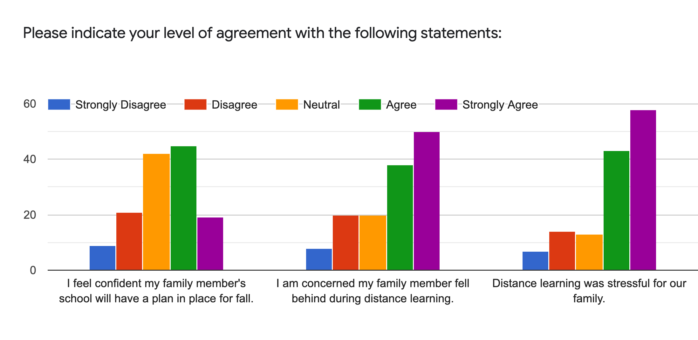
 | Please indicate your level of agreement with the following statements
 | I feel confident my family member's school will have a plan in place for fall. | I am concerned my family member fell behind during distance learning. | Distance learning was stressful for our family.
Strongly agree | 14% | 37% | 43%
Agree | 33% | 28% | 32%
Neutral | 31% | 15% | 10%
Disagree | 15% | 15% | 10%
Strongly disagree | 7% | 6% | 5%
Total | 100% | 100% | 100%

Slide 6
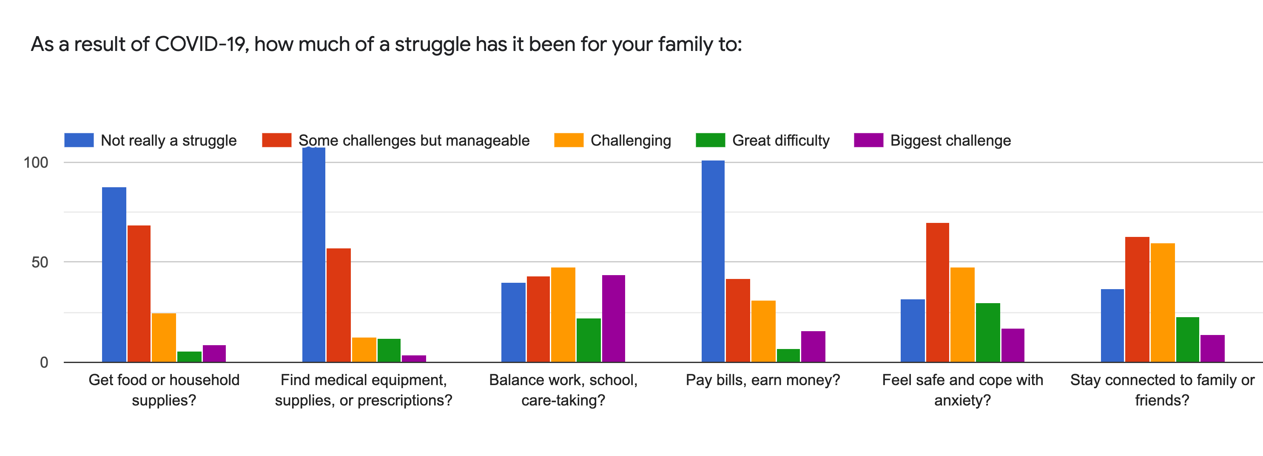

Slide 7
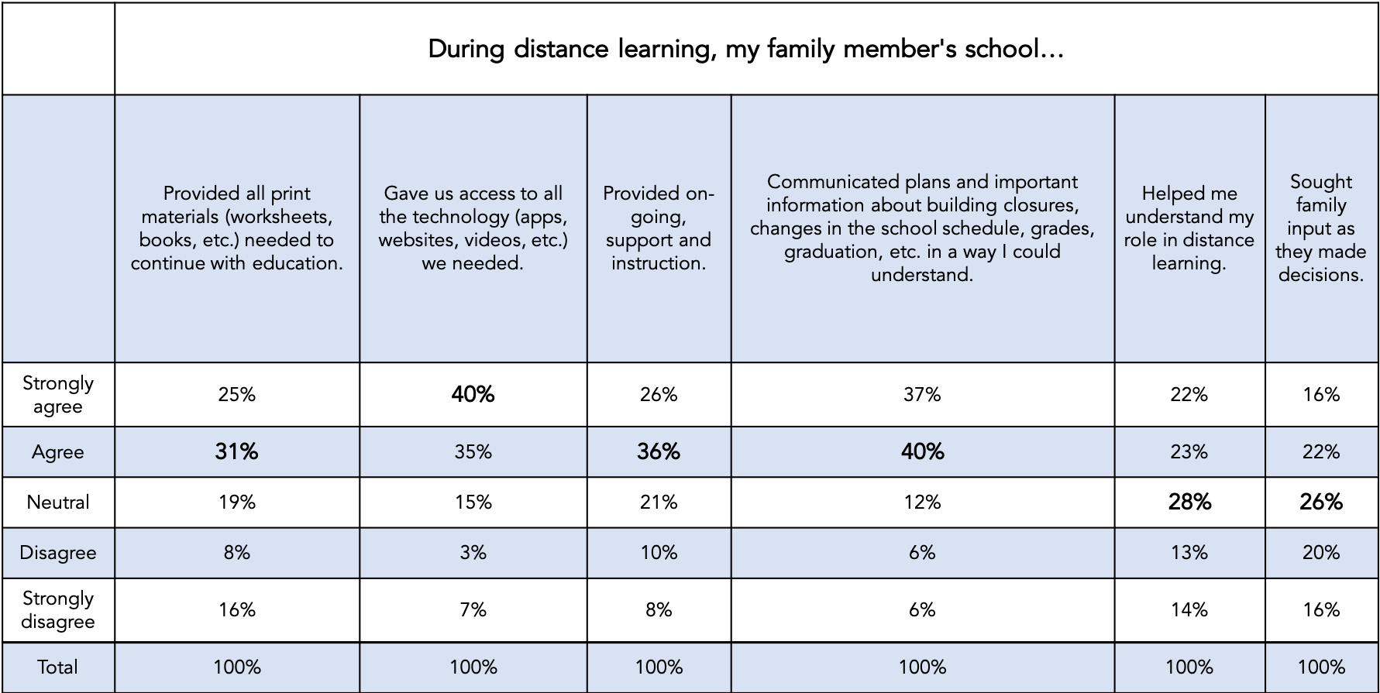

Slide 8
Toward Equitable Access
Trauma
  Real or perceived loss of agency
    Building closures happened “overnight”
    Very little “say” in what happened/how it happened
    Loss
    “Vulnerable” populations
    Teachers are often parents
Resilience
  Voice, choice, control
    Meaningful input
    Happening “with” not “to”
    Choice in big and small things
“Teachers, parents, and other members of the community not only need and deserve to be heard during the planning process, they can actually contribute crucial insights and expertise that will facilitate and accelerate the safe reopening of schools.”
- Robert Low, eSchool News

Slide 9
Priorities
Safety and well-being
  Physical safety
  Targeted PD (including trauma and resilience)
  Post-COVID culture building
Communication
  Time with positive, safe, adults
  Ongoing, meaningful input/choice
Learning/Opportunity gaps
Flexibility and contingency plans
  What if a learner can’t follow public health recommendations or needs physical assistance during the day?
  What if a learner needs to see faces/mouths (students who are deaf or hard of hearing; students during speech therapy; students who rely on facial expressions or ques)?
  What if an educator’s family gets sick or has a member who is medically fragile?
  What if we create entrances or routes to/through school that aren’t accessible or lead to long-lines in inclement weather?
  What if buildings need to close?

