Slide 1
Minority Health Strike Force Town Hall Meeting
Friday, June 5, 2020
Teresa L. Kobelt, MSW, LSW
Director – Strategy, Innovation, Forecasting

Slide 2
Minority Health Strike Force
Stop the progression of the disease.
Evaluate and document the impact of the disease.
Remedy factors that contribute to the spread.
Procure resources to prevent a resurgence of COVID-19.
CONSIDERATION: Disparities exist in recovery. Efforts to “evaluate and document the impact of the disease” should include short and long-term impacts with a focus on social determinants of health.
KEY QUESTION: Are minorities recovering – in every sense of the word?
COVID-19 Minority Health Strike Force: Interim Report https://coronavirus.ohio.gov/static/MHSF/COVID-19-SFR.pdf

Slide 3
Workforce – Direct Care
Women of color make up largest, fastest-growing segment of direct care workforce
From 2005 to 2015, women of color in direct care grew from 45 percent of the workforce (1.2 million workers) to 48 percent (1.7 million workers).
From 2016 to 2026, the number of women of color in the labor force is projected to grow by 6.3 million workers, while the number of white women in the labor force is projected to decline by 384,000 over the same time period
The poverty rate for women of color in direct care is higher than any other group – 22%
Forty-nine percent of women of color in direct care rely on public assistance

Slide 4
Workforce – Early Care
About 40% of early care workers are people of color. By comparison, 80% of K-12 teachers are white.
Center-based African American early educators are more likely to earn less than all other racial/ethnic groups in the early education workforce nationwide.
Even after controlling for educational attainment, African American workers still earn lower wages than white workers ($0.78 less per hour, or $1,622.40 less per year, for a full-time, full-year worker).

Slide 5
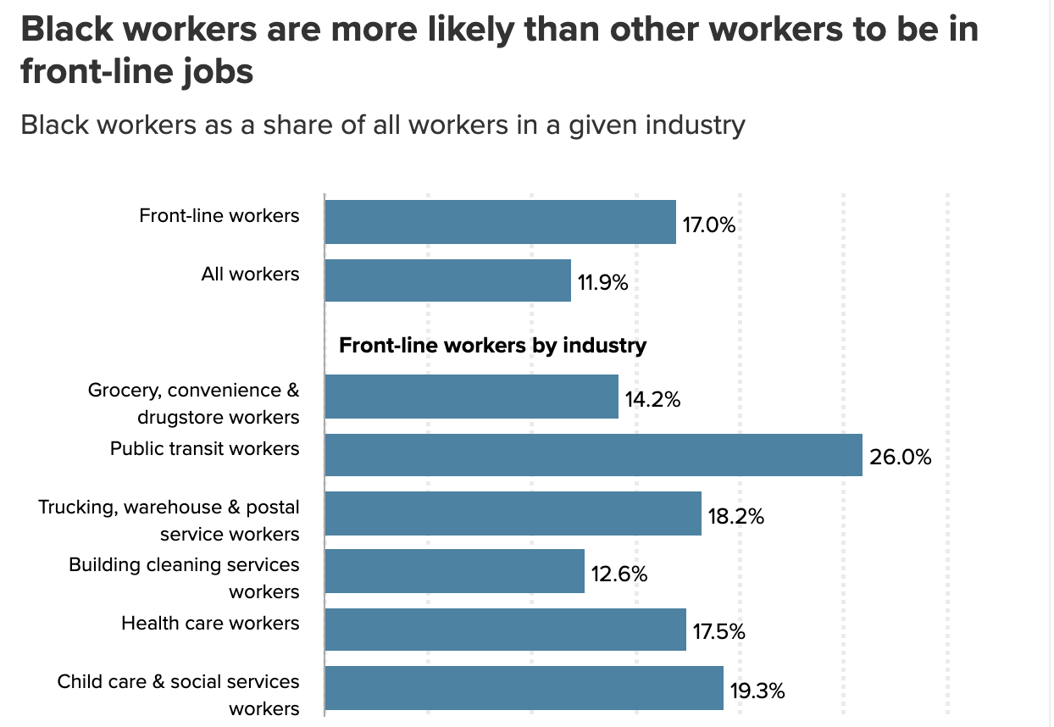
Workforce

Slide 6
Workforce – Employment Participation & Unemployment
As of April, less than half the adult black population was employed (employment to population ratio).
"Black workers are less able to weather such a storm because they have fewer earners in their families, lower incomes, and lower liquid wealth than white workers.”
Black women have experienced the highest rates of unemployment and the lowest rates of employment (two different measures)

Slide 7
Recommendations
Include recommendations that focus on the long-term impacts of the disease. Screening, testing, tracing AND recovering (educationally, economically, medically…).
To what extent are minorities returning to the workforce?
To what extent are minorities returning to educational environments?
To what extent have minorities recovered as measured by…(work with communities of color to define recovery)?
Recommendation #1: Recognize the contributions of minorities to front-line industries. Track and report (by race) unemployment, reemployment and/or employment participation in industries where minorities represent large portions of the workforce (i.e., direct care, early childhood). Leverage these worksites for screening, testing, education and outreach, and input.
Recommendation #2: Report on the number of minorities that have not had access to programs and services that directly impact social determinants of health (i.e., Head Start, School Lunch, etc.), prioritize such programs for restart/recovery, and track minorities “return” to these programs/services. Leverage these for screening, testing, education and outreach, and input.

