Slide 1
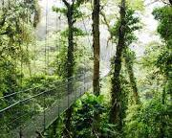
The Rainforest
by Ms. Gladman

Slide 2
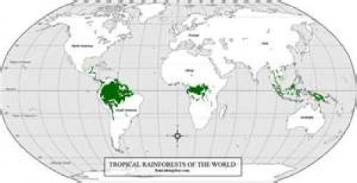
Rainforests are all over the world.

Slide 3
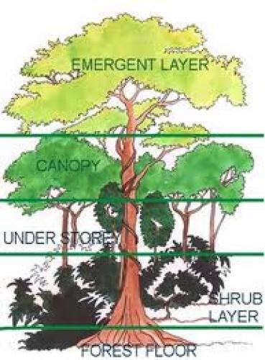
There are four main layers of the rainforest.

Slide 4
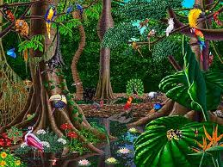
Animals live in all of the different layers.

Slide 5
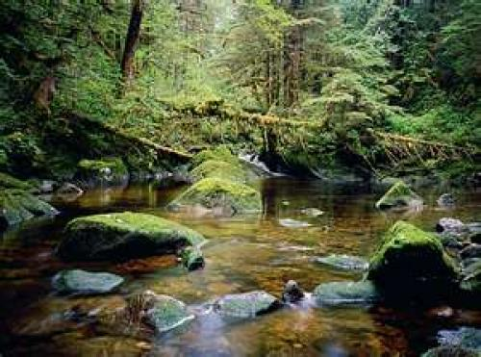
The forest floor is the lowest layer in the rainforest.

Slide 6
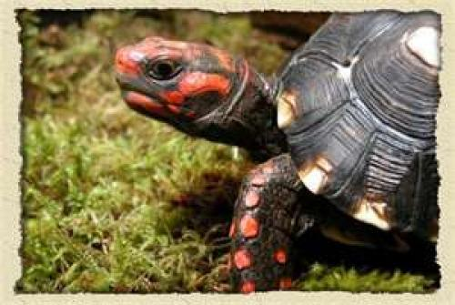
Turtles live on the rainforest floor.

Slide 7
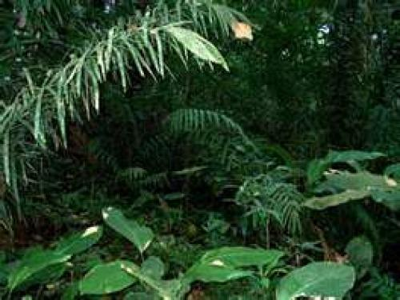
The understory are the shrubs and lower tree trunks.

Slide 8
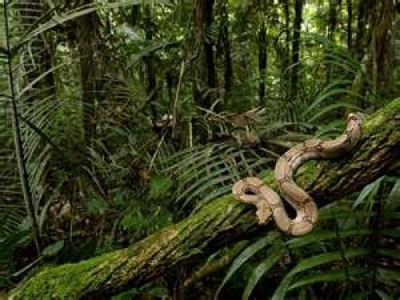
Snakes live in the understory.

Slide 9
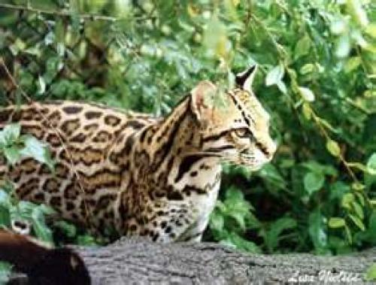
Jaguars also live in the understory.

Slide 10
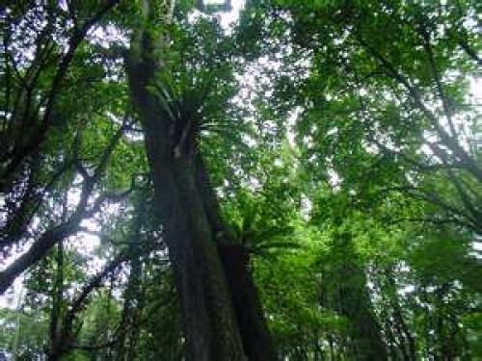
The canopy layer is the tree trunks.

Slide 11
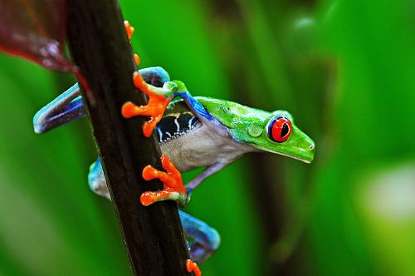
The red eyed tree frog lives in the canopy layer.

Slide 12
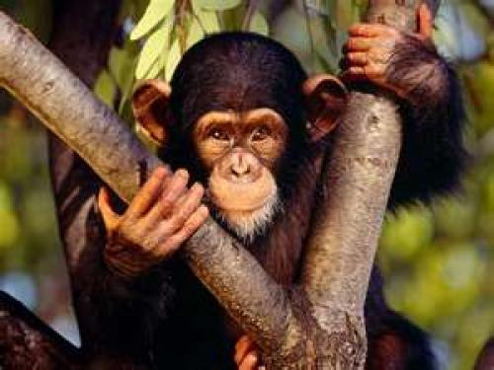
Chimpanzees also live in the canopy.

Slide 13
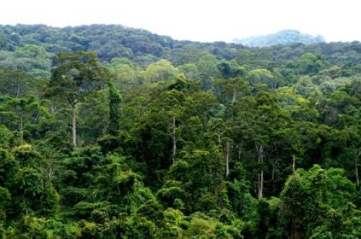
The emergent layer is the highest layer, the top of the trees.

Slide 14
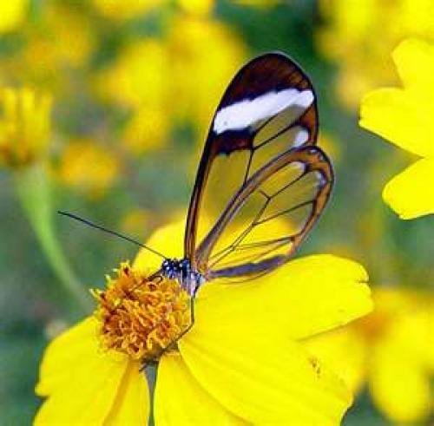
Butterflies live in the emergent layer.

Slide 15
Here are some of the animals of the rainforest.

